Slide 1

DISCRETE MATHEMATICS
Chapter 6:
GRAPH THEORY
Presenter: Ph.D. Phu-Nguyen Le
June 7th, 2023
1

Slide 2
Introduction
6.1. BASIC CONCEPTS OF GRAPHS.
    6.1.1. Undirected & directed graph.
    6.1.2. Graphical representation.
    6.1.3.Some special graphs.
6.2. PLANAR GRAPH, AND NOT FLAT.
6.2.1. Subgraph.
6.2.2. Planar graph and properties.
6.2.3. Euler's cycle and Hamiltonian cycle.
2

Slide 3
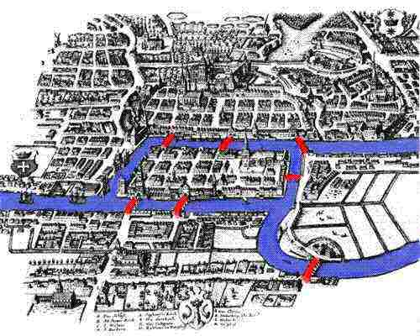
6.1 BASIC CONCEPTS OF GRAPHS
6.1.1 Undirected & directed graph
3

Slide 4
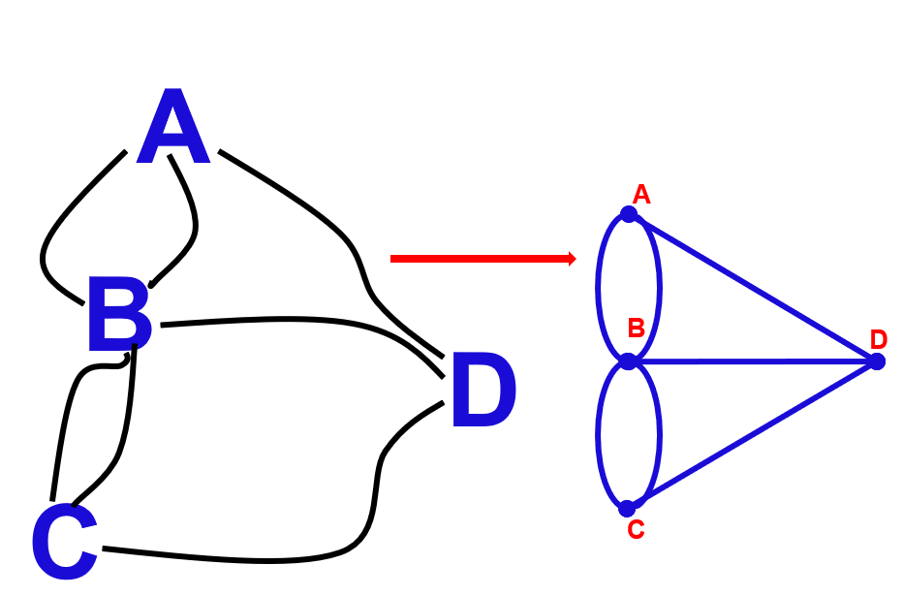
6.1 BASIC CONCEPTS OF GRAPHS
6.1.1 Undirected & directed graph
4

Slide 5
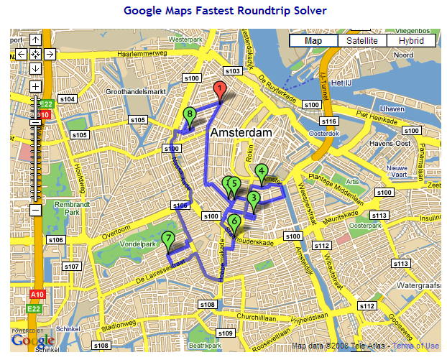
6.1 BASIC CONCEPTS OF GRAPHS
6.1.1 Undirected & directed graph
5

Slide 6
6.1 BASIC CONCEPTS OF GRAPHS
6.1.1 Undirected & directed graph
Let's assume there are 6 tasks that need to be done: A, B, C, D, E, F.
Task A: Must be done before tasks B, D.
Task B: Must be done before task D.
Task C: Must be done after task F, before A.
Task D: Must be done after tasks A, B, E.
Task E: Must be done before tasks B, D, F.
Please find a sequence to perform the tasks that satisfies the given requirements.
6

Slide 7
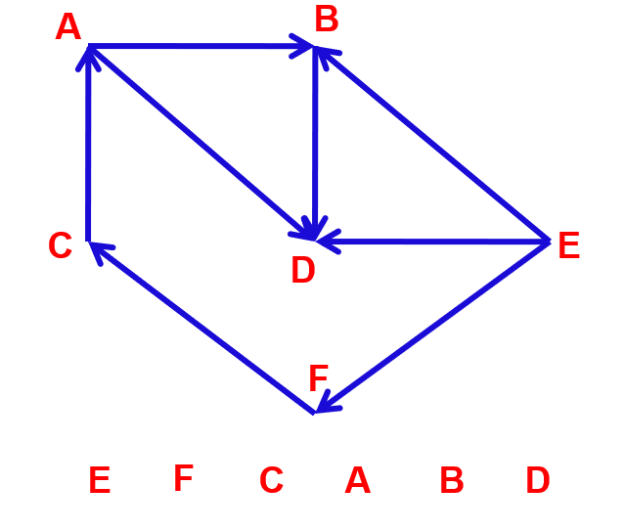
6.1 BASIC CONCEPTS OF GRAPHS
6.1.1 Undirected & directed graph
7

Slide 8
6.1 BASIC CONCEPTS OF GRAPHS
6.1.1 Undirected & directed graph
Graph theory was initiated in 1736 by Leonard Euler when he wrote a paper on the Seven Bridges of Königsberg problem.
Some notable scientists and their important contributions:
Hamilton: Hamiltonian graphs and related problems.
Dijkstra, Floyd, Warshall, Bellman: Algorithms for finding shortest paths.
Prim, Kruskal: Algorithms for finding minimum spanning trees.
8

Slide 9
6.1 BASIC CONCEPTS OF GRAPHS
6.1.1 Undirected & directed graph
In mathematics, graph theory is the study of graphs, which are mathematical structures used to model pairwise relations between objects.
A graph in this context is made up of vertices (also called nodes or points) which are connected by edges (also called links or lines).
A distinction is made between undirected graphs, where edges link two vertices symmetrically, and directed graphs, where edges link two vertices asymmetrically..
9

Slide 10
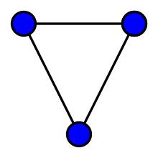
6.1 BASIC CONCEPTS OF GRAPHS
6.1.1 Undirected & directed graph
An undirected graph is an ordered pair G=(V,E) comprising:
V, a set of vertices (also called nodes or points);
E⊆{{x,y}∣x,y∈V² and x≠y} a set of edges (also called links or lines), which are unordered pairs of vertices (that is, an edge is associated with two distinct vertices).
A graph with three vertices and three edges.
10
Notes:
To avoid ambiguity, this type of object may be called precisely an undirected simple graph..

Slide 11
6.1 BASIC CONCEPTS OF GRAPHS
6.1.1 Undirected & directed graph
In the edge {x,y}, the vertices x and y are called the endpoints of the edge. The edge is said to join x and y and to be incident on x and on y.
A vertex may exist in a graph and not belong to an edge.
Multiple edges are two or more edges that join the same two vertices
A loop is an edge that joins a vertex to itself
Degree of vertex X are the number of edges connected to X
11
Notes:
To avoid ambiguity, this type of object may be called precisely an undirected simple graph..

Slide 12
6.1 BASIC CONCEPTS OF GRAPHS
6.1.1 Undirected & directed graph
Simple graph
A graph which no loop, no multiple edges
Multi-graph
A graph which is permitted to have multiple edges (also called parallel edges, that is, edges that have the same end nodes, or. Thus two vertices may be connected by more than one edge.
A graph which loop(s)
12
Notes:
To avoid ambiguity, this type of object may be called precisely an undirected simple graph..

Slide 13
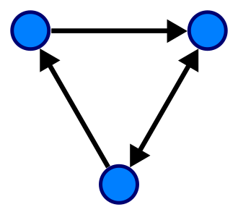
6.1 BASIC CONCEPTS OF GRAPHS
6.1.1 Undirected & directed graph
Directed graph:
A single directed graph is a set G=<V,E>,
V is a finite set of vertices of the graph.
E is the set of ordered pairs of two
different elements of V called arcs.
13
Notes:
To avoid ambiguity, this type of object may be called precisely an undirected simple graph..

Slide 14
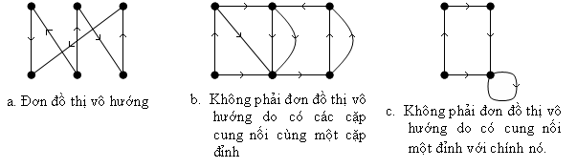
6.1 BASIC CONCEPTS OF GRAPHS
6.1.1 Undirected & directed graph
Directed graph:
14
Notes:
To avoid ambiguity, this type of object may be called precisely an undirected simple graph..

Slide 15
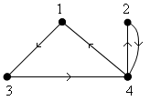
6.1 BASIC CONCEPTS OF GRAPHS
6.1.2. Graphical representation.
By adjacency matrix:
Let the graph G = <V, E>, with V = {v₁, v₂, …, v_{n}}. The adjacency matrix representing G is a square matrix A, size nxn, defined as follows:
15
Notes:
Tại sao phải biểu diễn đồ thị trên máy tính???
Lý thuyết đồ thị ngày càng được ứng dụng rộng rãi.
Để xây dựng được các ứng dụng của đồ thị trên máy tính thì cần phải tìm cách biểu diễn đồ thị trên máy tính thích hợp.
Máy tính không thể hiểu được các đồ thị dưới dạng hình vẽ thông thường.
Tiêu chuẩn để lựa chọn cách thức biểu diễn đồ thị trên máy tính?
Cấu trúc dữ liệu phải đơn giản, phù hợp với từng bài toán ứng dụng.
Dễ biểu diễn, dễ cài đặt các ứng dụng trên đó.
Ở cách biểu diễn ma trận này, ma trận sẽ không biểu diễn được:
Đồ thị có cạnh song song
Ưu điểm lớn nhất của phương pháp biểu diễn đồ thị bằng ma trận kề là để trả lời câu hỏi: Hai đỉnh u,v có kề nhau trên đồ thị hay không, chúng ta chỉ phải thực hiện một phép so sánh.
Nhược điểm lớn nhất của phương pháp này là: không phụ thuộc vào số cạnh của đồ thị, ta luôn phải sử dụng n^2 đơn vị bộ nhớ để lưu trữ ma trận kề của nó.

Slide 16
6.1 BASIC CONCEPTS OF GRAPHS
6.1.2. Graphical representation.
By adjacency matrix:
Ex:?
15
Notes:
Tại sao phải biểu diễn đồ thị trên máy tính???
Lý thuyết đồ thị ngày càng được ứng dụng rộng rãi.
Để xây dựng được các ứng dụng của đồ thị trên máy tính thì cần phải tìm cách biểu diễn đồ thị trên máy tính thích hợp.
Máy tính không thể hiểu được các đồ thị dưới dạng hình vẽ thông thường.
Tiêu chuẩn để lựa chọn cách thức biểu diễn đồ thị trên máy tính?
Cấu trúc dữ liệu phải đơn giản, phù hợp với từng bài toán ứng dụng.
Dễ biểu diễn, dễ cài đặt các ứng dụng trên đó.
Ở cách biểu diễn ma trận này, ma trận sẽ không biểu diễn được:
Đồ thị có cạnh song song
Ưu điểm lớn nhất của phương pháp biểu diễn đồ thị bằng ma trận kề là để trả lời câu hỏi: Hai đỉnh u,v có kề nhau trên đồ thị hay không, chúng ta chỉ phải thực hiện một phép so sánh.
Nhược điểm lớn nhất của phương pháp này là: không phụ thuộc vào số cạnh của đồ thị, ta luôn phải sử dụng n^2 đơn vị bộ nhớ để lưu trữ ma trận kề của nó.

Slide 17
6.1 BASIC CONCEPTS OF GRAPHS
6.1.2. Graphical representation.
By incident matrix:
Undirected graph
v_{i} vertices of e_{j}
v_{i} not vertices of e_{j}
17

Slide 18
6.1 BASIC CONCEPTS OF GRAPHS
6.1.2. Graphical representation.
By incident matrix:
Directed graph
v_{i} start point of e_{j}
v_{i} end point of e_{j}
v_{i} not a point of e_{j}
18
Notes:
Trong ma trận của đồ thị có hướng tổng bậc ra của các đỉnh = Tổng bậc vào của các đỉnh = Đỉnh.
Trong ma trận của đồ thị vô hướng tổng bậc của tất cả các đỉnh = 2 lần số cạnh.
Ưu điểm:
Đồ thị có cạnh song song
Ma trận liên thuộc đỉnh-cạnh sẽ tiết kiệm bộ nhớ hơn khi đồ thị có ít cạnh/cung.
Khuyết điểm:
Biểu diễn phức tạp

Slide 19
6.1 BASIC CONCEPTS OF GRAPHS
6.1.2. Graphical representation.
By incident matrix:
1
e₁
2
e₂
3
e₄
e₃
e₇
e₅
4
e₆
5
6
19

Slide 20
6.1 BASIC CONCEPTS OF GRAPHS
6.1.2. Graphical representation.
By incident matrix:
e₁
e₅
e₂
e₄
e₃
20

Slide 21
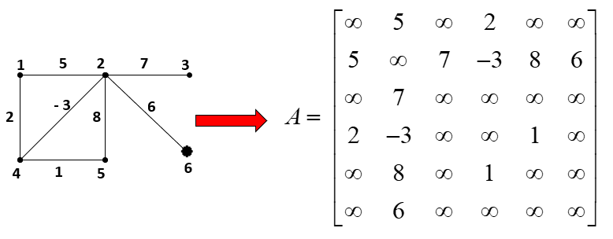
6.1 BASIC CONCEPTS OF GRAPHS
6.1.2. Graphical representation.
By weight matrix:
21
Notes:
Ở cách biểu diễn ma trận này, ma trận sẽ không biểu diễn được:
Đồ thị có cạnh song song
Ở cách biểu diễn ma trận này, ma trận có thể biểu diễn được:
Đồ thị có khuyên

Slide 22
6.1 BASIC CONCEPTS OF GRAPHS
6.1.2. Graphical representation.
By edge list
Start | End
1 | 3
4 | 1
3 | 4
4 | 2
2 | 4
e₁
e₄
e₂
e₅
e₃
22

Slide 23
6.1 BASIC CONCEPTS OF GRAPHS
6.1.2. Graphical representation.
By adjacency list
1
3
NULL
2
4
NULL
3
4
NULL
4
1
2
NULL
23

Slide 24
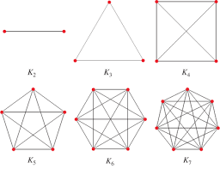

6.1 BASIC CONCEPTS OF GRAPHS
6.1.3.Some special graphs.
A complete graph is a simple undirected graph in which every pair of distinct vertices is connected by a unique edge. A complete digraph is a directed graph in which every pair of distinct vertices is connected by a pair of unique edges
24

Slide 25
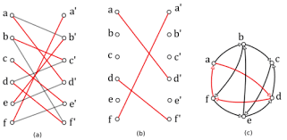
6.1 BASIC CONCEPTS OF GRAPHS
6.1.3.Some special graphs.
a bipartite graph (or bigraph) is a graph whose vertices can be divided into two disjoint and independent sets U and V, that is, every edge connects a vertex in U to one in
V. Vertex sets U and V are usually called the parts of the graph.
25

Slide 26
6.2 PLANAR, AND NOT FLAT GRAPH
6.2.1. Subgraph.
Degree of vertices: the number of edges connected to vertices
26

Slide 27
6.2 PLANAR, AND NOT FLAT GRAPH
6.2.1. Subgraph.
Degree of vertices in directed graph:
+ inner degree deg⁻
+ outer degree deg⁺
27

Slide 28
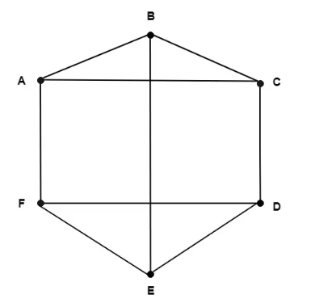
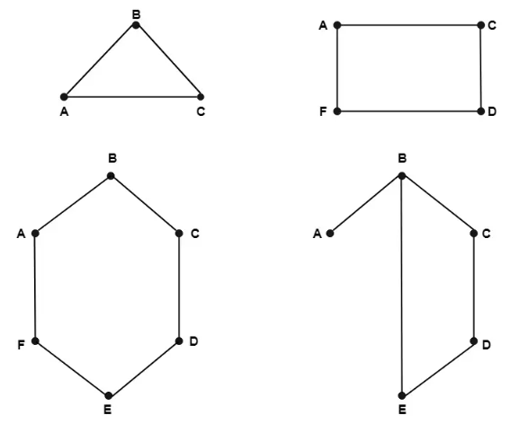
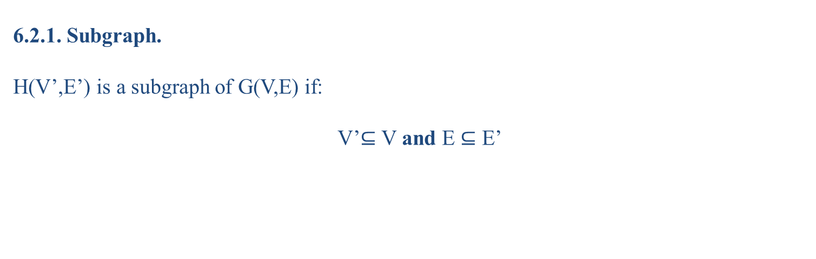
6.2 PLANAR, AND NOT FLAT GRAPH
6.2.1. Subgraph.
H(V’,E’) is a subgraph of G(V,E) if:
V’$⊆$ V and E $⊆$ E’
28

Slide 29
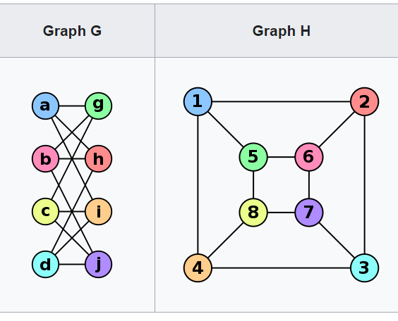
6.2 PLANAR, AND NOT FLAT GRAPH
6.2.1. Subgraph.
Isomorphism of graphs G and H is a bijection between the vertex sets of G and H:
f:V(G)→V(H)
such that any two vertices u and v of G are adjacent in G if and only if f(u) and f(v) are adjacent in H.
29
Notes:
Cùng số đỉnh.
Cùng số đỉnh bậc k, mọi k nguyên dương ≥ 0.
Cùng số cạnh.
Cùng số thành phần.

Slide 30
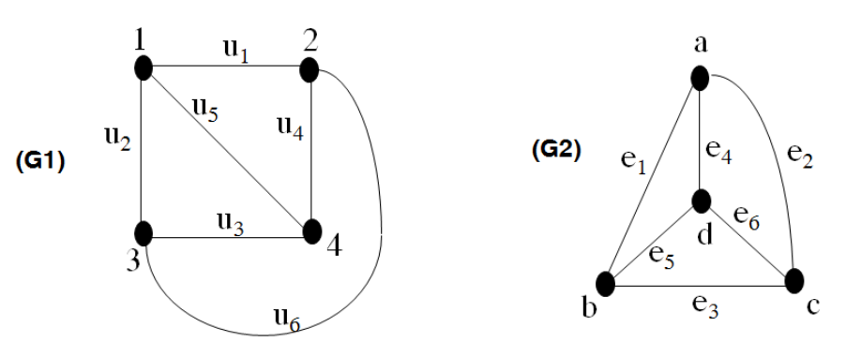
6.2 PLANAR, AND NOT FLAT GRAPH
6.2.1. Subgraph.
30

Slide 31
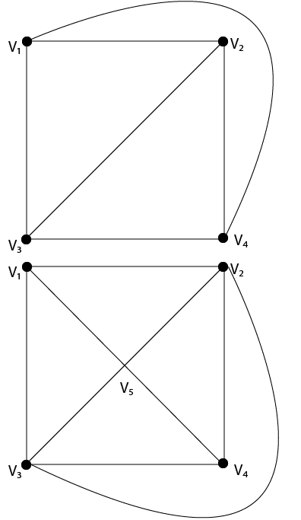
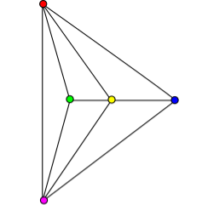
6.2 PLANAR, AND NOT FLAT GRAPH
6.2.2. Planar graph and properties.
A graph is said to be planar if it can be drawn in a plane so that no edge cross.
31

Slide 32
6.2 PLANAR, AND NOT FLAT GRAPH
6.2.2. Planar graph and properties.
Region of a Graph: Consider a planar graph G=(V,E).A region is defined to be an area of the plane that is bounded by edges and cannot be further subdivided. A planar graph divides the plans into one or more regions. One of these regions will be infinite.
Finite Region: If the area of the region is finite, then that region is called a finite region
Infinite Region: If the area of the region is infinite, that region is called a infinite region. A planar graph has only one infinite region.
32

Slide 33
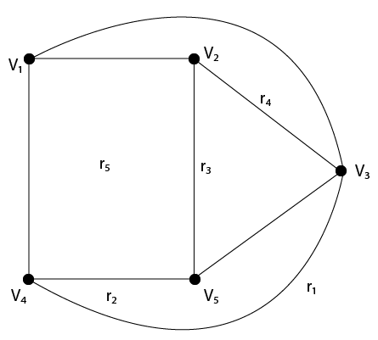
6.2 PLANAR, AND NOT FLAT GRAPH
6.2.2. Planar graph and properties.
33

Slide 34
6.2 PLANAR, AND NOT FLAT GRAPH
6.2.2. Planar graph and properties.
Properties of Planar Graphs:
  If a connected planar graph G has e edges and r regions, then r ≤ 2/3 e.
  If a connected planar graph G has e edges, v vertices, and r regions, then v-e+r=2.
  If a connected planar graph G has e edges and v vertices, then 3v-e≥6.
  A complete graph K_{n} is a planar if and only if n<5.
  A complete bipartite graph K_{mn} is planar if and only if m<3 or n>3.
34

Slide 35
6.2 PLANAR, AND NOT FLAT GRAPH
6.2.3 Euler's cycle and Hamiltonian cycle.
Path
For a graph G=(X, U).
A path in G is a sequence alternating between vertices and edges: x₁ u₁ x₂ u₂... x_{m-1} u_{m-1}1 x_{m} (x_{i} is a vertex and u_{i} is an edge) in the graph that satisfies the condition that u_{i} connects the vertex pair (x_{i}, x_{i+1}),
u_{i}=(x_{i}, x_{i+1}) if the graph is directed,
u_{i}={x_{i}, x_{i+1}} if the graph is undirected.
In this case, x₁ is called the starting vertex and x_{m} is the ending vertex of the path.
The "single" nature of a chain or path requires that no border appear twice in the path.
The "primary" (aka "secondary") quality requires that no vertices appear twice.
35

Slide 36
6.2 PLANAR, AND NOT FLAT GRAPH
6.2.3 Euler's cycle and Hamiltonian cycle.
Cycle
A path that starts and ends at the same point (k>=3) is called a cycle.
Connectivity
In an undirected graph G, two vertices u and v are called connected if G contains a path from u to v. Otherwise, they are called disconnected.
If the two vertices are additionally connected by a path of length 1, i.e. by a single edge, the vertices are called adjacent.
A graph is said to be connected if every pair of vertices in the graph is connected.
An undirected graph that is not connected is called disconnected.
An undirected graph G is therefore disconnected if there exist two vertices in G such that no path in G has these vertices as endpoints.
36

Slide 37
6.2 PLANAR, AND NOT FLAT GRAPH
6.2.3 Euler's cycle and Hamiltonian cycle.
A graph with just one vertex is connected.
An edgeless graph with two or more vertices is disconnected.
A directed graph is called weakly connected if replacing all of its directed edges with undirected edges produces a connected (undirected) graph.
It is unilaterally connected or unilateral (also called semi-connected) if it contains a directed path from u to v or a directed path from v to u for every pair of vertices u, v.
It is strongly connected, or simply strong, if it contains a directed path from u to v and a directed path from v to u for every pair of vertices u, v.
37

Slide 38
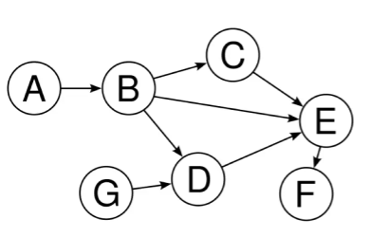
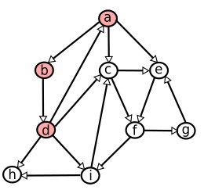
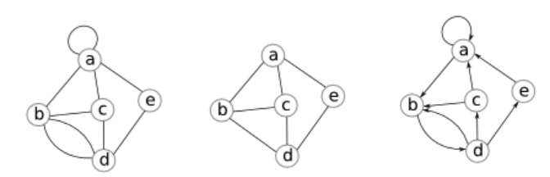
6.2 PLANAR, AND NOT FLAT GRAPH
6.2.3 Euler's cycle and Hamiltonian cycle.
38

Slide 39
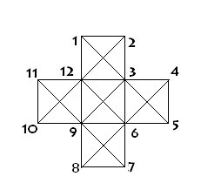
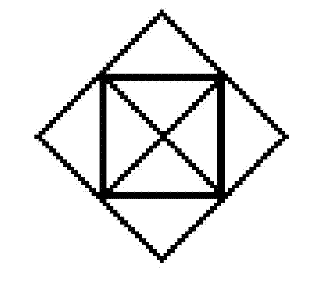
6.2 PLANAR, AND NOT FLAT GRAPH
6.2.3 Euler's cycle and Hamiltonian cycle.
Euler's cycle
Draw the following shapes with a single pen stroke (do not lift the pen while drawing).
39
Notes:
Không vẽ được bằng 1 nét. Tối thiểu phải vẽ bằng 2 nét.
Không vẽ được bằng 1 nét. Tối thiểu phải vẽ bằng 6 nét.

Slide 40
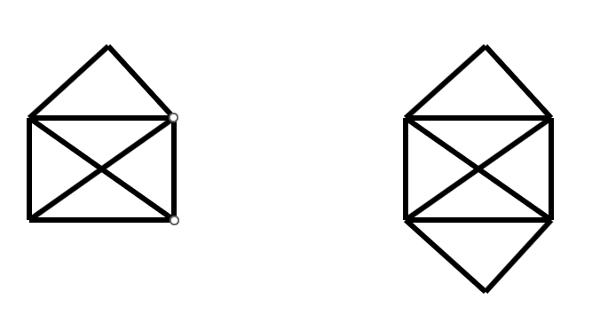
6.2 PLANAR, AND NOT FLAT GRAPH
6.2.3 Euler's cycle and Hamiltonian cycle.
Euler's cycle
Draw the following shapes with a single pen stroke (do not lift the pen while drawing).
40

Slide 41
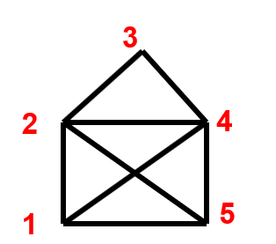
6.2 PLANAR, AND NOT FLAT GRAPH
6.2.3 Euler's cycle and Hamiltonian cycle.
Euler's cycle
Consider the graph G = <V,E>.
A path on the graph is called an Eulerian path if it traverses all edges, each edge once.
An Eulerian cycle on the graph is a cycle that goes through all edges, each edge once
EX.:
Eulerian path :
d1: 1 2 3 4 2 5 4 1 5
d2: 1 2 4 3 2 5 1 4 5
41

Slide 42
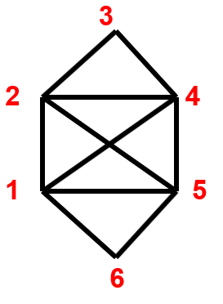
6.2 PLANAR, AND NOT FLAT GRAPH
6.2.3 Euler's cycle and Hamiltonian cycle.
Euler's cycle
Eulerian cycles :
c1: 1 2 3 4 2 5 4 1 5 6 1
c2: 1 2 4 3 2 5 1 4 5 6 1
42

Slide 43
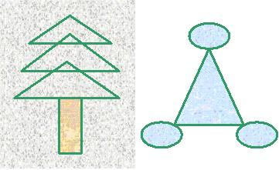
6.2 PLANAR, AND NOT FLAT GRAPH
6.2.3 Euler's cycle and Hamiltonian cycle.
Euler's cycle / Euler’s path
43
Notes:
Euler's cycle / Euler’s path

Slide 44
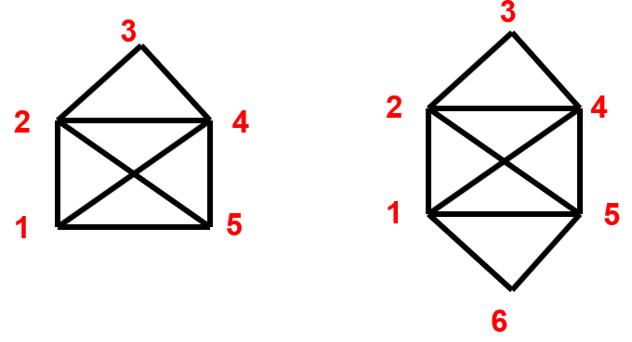
6.2 PLANAR, AND NOT FLAT GRAPH
6.2.3 Euler's cycle and Hamiltonian cycle.
A graph is called an Eulerian graph if an only if exist an Eulerian cycle in the graph
A graph is called a half Eulerian graph if an only if exist an Eulerian path in the graph
44
Notes:
Euler's cycle / Euler’s path

Slide 45
6.2 PLANAR, AND NOT FLAT GRAPH
6.2.3 Euler's cycle and Hamiltonian cycle.
Theorem. A connected undirected graph G is an Eulerian graph if and only if every vertex of it has an even degree.
Corollary. A connected undirected graph G is a semi-Eulerian graph if and only if it has at most two vertices with odd degrees.
45
Notes:
Euler's cycle / Euler’s path

Slide 46
6.2 PLANAR, AND NOT FLAT GRAPH
6.2.3 Euler's cycle and Hamiltonian cycle.
Theorem: Consider G to be a strongly connected directed graph. Then, G is an Eulerian graph if and only if every vertex of G has an equal out-degree and in-degree
46
Notes:
Euler's cycle / Euler’s path

Slide 47
6.2 PLANAR, AND NOT FLAT GRAPH
6.2.3 Euler's cycle and Hamiltonian cycle.
Find the Eulerian cycle:
Rule 1: After pass any edge, delete it
Rule 2: Only pass a bridge if there is no other choice
47
Notes:
Euler's cycle / Euler’s path

Slide 48
6.2 PLANAR, AND NOT FLAT GRAPH
6.2.3 Euler's cycle and Hamiltonian cycle.
Step | Vertex | List edges to the vertex | Edge | Bridge? Other choice? | Delete
1 | 1 | (1,2); (1,4);(1,5);(1,6) | (1,2) | N | (1,2)
2 | 2 | (2,3);(2,4);(2;5) | (2,3) | N | (2,3)
3 | 3 | (3,4) | (3,4) | Y, N | (3,4)
4 | 4 | (4,2);(4,1);(4,5) | (4,1) | N | (4,1)
5 | 1 | (1,5);(1;6) | (1,5) | N | (1,5)
6 | 5 | (5,2); (5,6) | (5,2) | N | (5,2)
7 | 2 | (2,4) | (2,4) | Y,N | (2,4)
8 | 4 | (4,5) | (4,5) | Y,N | (4,5)
9 | 5 | (5,6) | (5,6) | Y,N | (5,6)
10 | 6 | (6,1) | (6,1) | Y,N | (6,1)
11 | 1
48
Notes:
Euler's cycle / Euler’s path

Slide 49
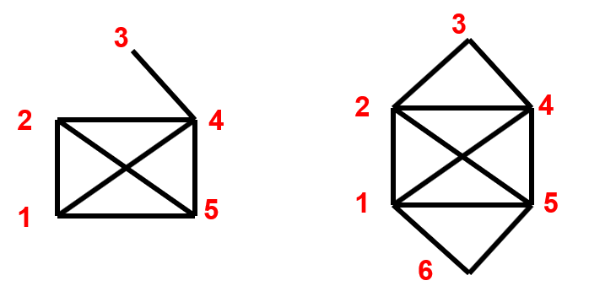
6.2 PLANAR, AND NOT FLAT GRAPH
6.2.3 Euler's cycle and Hamiltonian cycle.
Hamiltonian cycle
Consider the graph G = <V,E>.
The graph G is called a Hamiltonian graph if and only if there exists a Hamiltonian cycle in G.
The graph G is called a semi-Hamiltonian graph if and only if there exists a Hamiltonian path in G
49
Notes:
Euler's cycle / Euler’s path

Slide 50
6.2 PLANAR, AND NOT FLAT GRAPH
6.2.3 Euler's cycle and Hamiltonian cycle.
Hamiltonian cycle
Theorem (Dirac, 1952). Consider G to be an undirected simple graph with n vertices (n > 2). If every vertex of G has a degree of at least n/2, then G is a Hamiltonian graph.
Theorem (Dirac, 1952). Consider G to be a strongly connected directed simple graph with n vertices (n > 2). If every vertex of G has an out-degree and in-degree of at least n/2, then G is a Hamiltonian graph
Theorem (Ore, 1960): For a graph G with n vertices. If any two non-adjacent vertices of G have a sum of degrees at least n, then G is a Hamiltonian graph. In other words:
50
Notes:
Euler's cycle / Euler’s path

Slide 51
6.2 PLANAR, AND NOT FLAT GRAPH
6.2.3 Euler's cycle and Hamiltonian cycle.
Hamiltonian cycle
Rules for determining Hamiltonian cycles (H) in a graph:
Rule 1: If there is a vertex of degree 2, then both edges of this vertex must be included in H.
Rule 2: There should not be any subcycle (of length less than n) within H.
Rule 3: For a particular vertex, if you have already selected both incoming edges into H, then you must remove all other remaining edges (since you can't add more).
No isolated vertices or pendant vertices exist when applying rule 3.
51
Notes:
Euler's cycle / Euler’s path

Slide 52
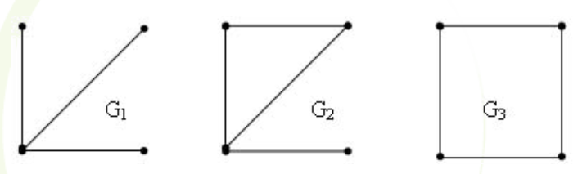
6.2 PLANAR, AND NOT FLAT GRAPH
6.2.3 Euler's cycle and Hamiltonian cycle.
Hamiltonian cycle
52
Notes:
Euler's cycle / Euler’s path

Slide 53
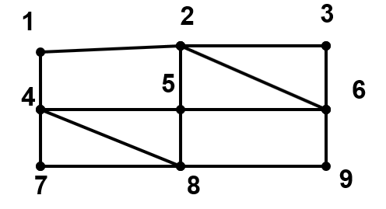
6.2 PLANAR, AND NOT FLAT GRAPH
6.2.3 Euler's cycle and Hamiltonian cycle.
Hamiltonian cycle
53
Notes:
Euler's cycle / Euler’s path

Slide 54
THANK YOU!

